Slide 1

Mobile Application Research Project
Etienne Theunissen
Michael Janse v. Rensburg
Alex Romburgh
Ryan Kok
Nicolaas Geldenhuys

Slide 2
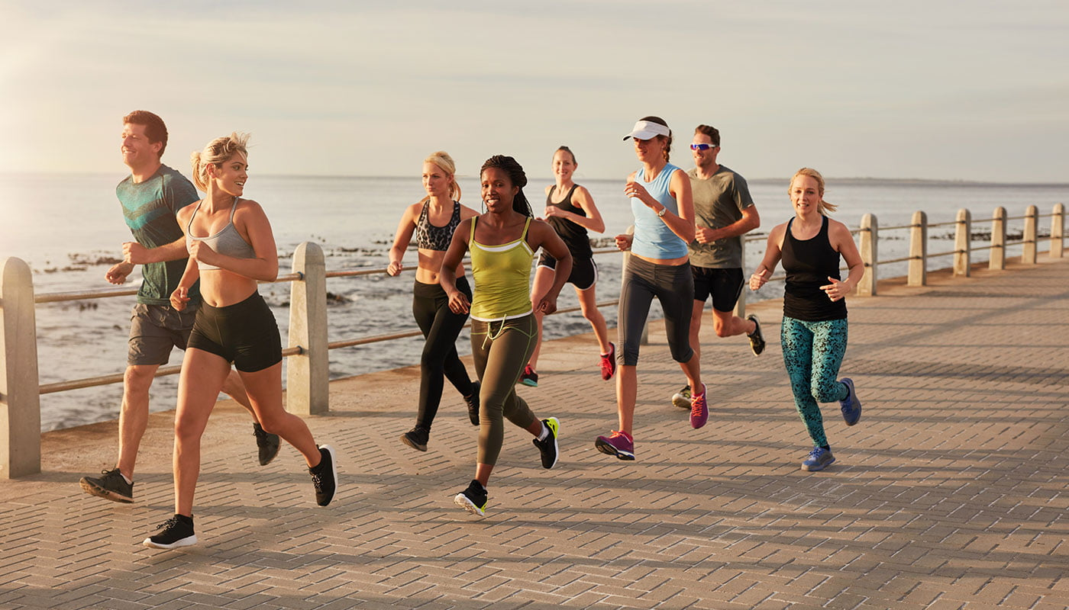
Introduction
Target: Fitness Industry
Client: The 5AM Club
Project: Mobile application

Slide 3
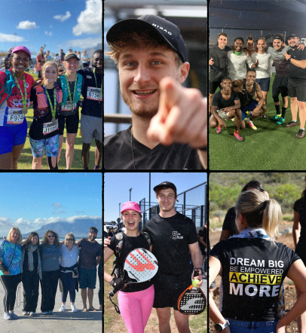
Company background:
The 5am Club is a fitness community based in Bloubergstrand, Cape Town. It was founded in 2021 by Joshua Bransgrove in response to the isolation induced by COVID-19. Joshua Bransgrove saw that there was a lack of community and personal connection in the Bloubergstrand area. He wanted to motivate his friends and the people around him in a way that hadn’t been done before. Ironically, it began by running with his friends in Bloubergstrand at 5 AM. Thereafter as the community grew, they hosted different activities at different times. The clubs hosted under “The 5am Club” include:
Walking Club (walks along the beach promenade/beachfront twice a week)
Running Club (runs along the beach promenade five times a week)
Hiking Club (hikes hosted once a month)
Fives Club (soccer with social and league matches each week)
Padel Club (weekly games at Atlantic Padel)
Success Club (webinars educating people on the principles behind success)

Slide 4






RESEARCH OVERVIEW

Slide 5

Aims & Objectives
Make an application that the members can use to easily view services offered by The 5am Club.
The member should be able to join clubs and view events without any difficulty.
The members should be able to have access to information regarding training regiments, clubs and events.

Slide 6

Problem Statements & Solutions
Problems:
Past plans revealed it to be too expensive.
Competitors have a competitive edge.
User friendliness.
Solutions:
Cost: Sacrifice some functionality/requirements with the initial release or develop over longer timeline.
Competitive edge: Hold fitness events to increase customer base. Release a mobile application of their own
User friendliness: The app has few pages and a navbar for better navigation.
Sub-Problems:
Too expensive:
Too little time to create all the functions.
The company is being overcharged
Competitors have competitive edge:
The competitors are larger companies.
The mobile application created for The 5am Club is not up to par with that of their competitors.
User friendliness:
The application has too many features.
The application is oversimplified.

Slide 7
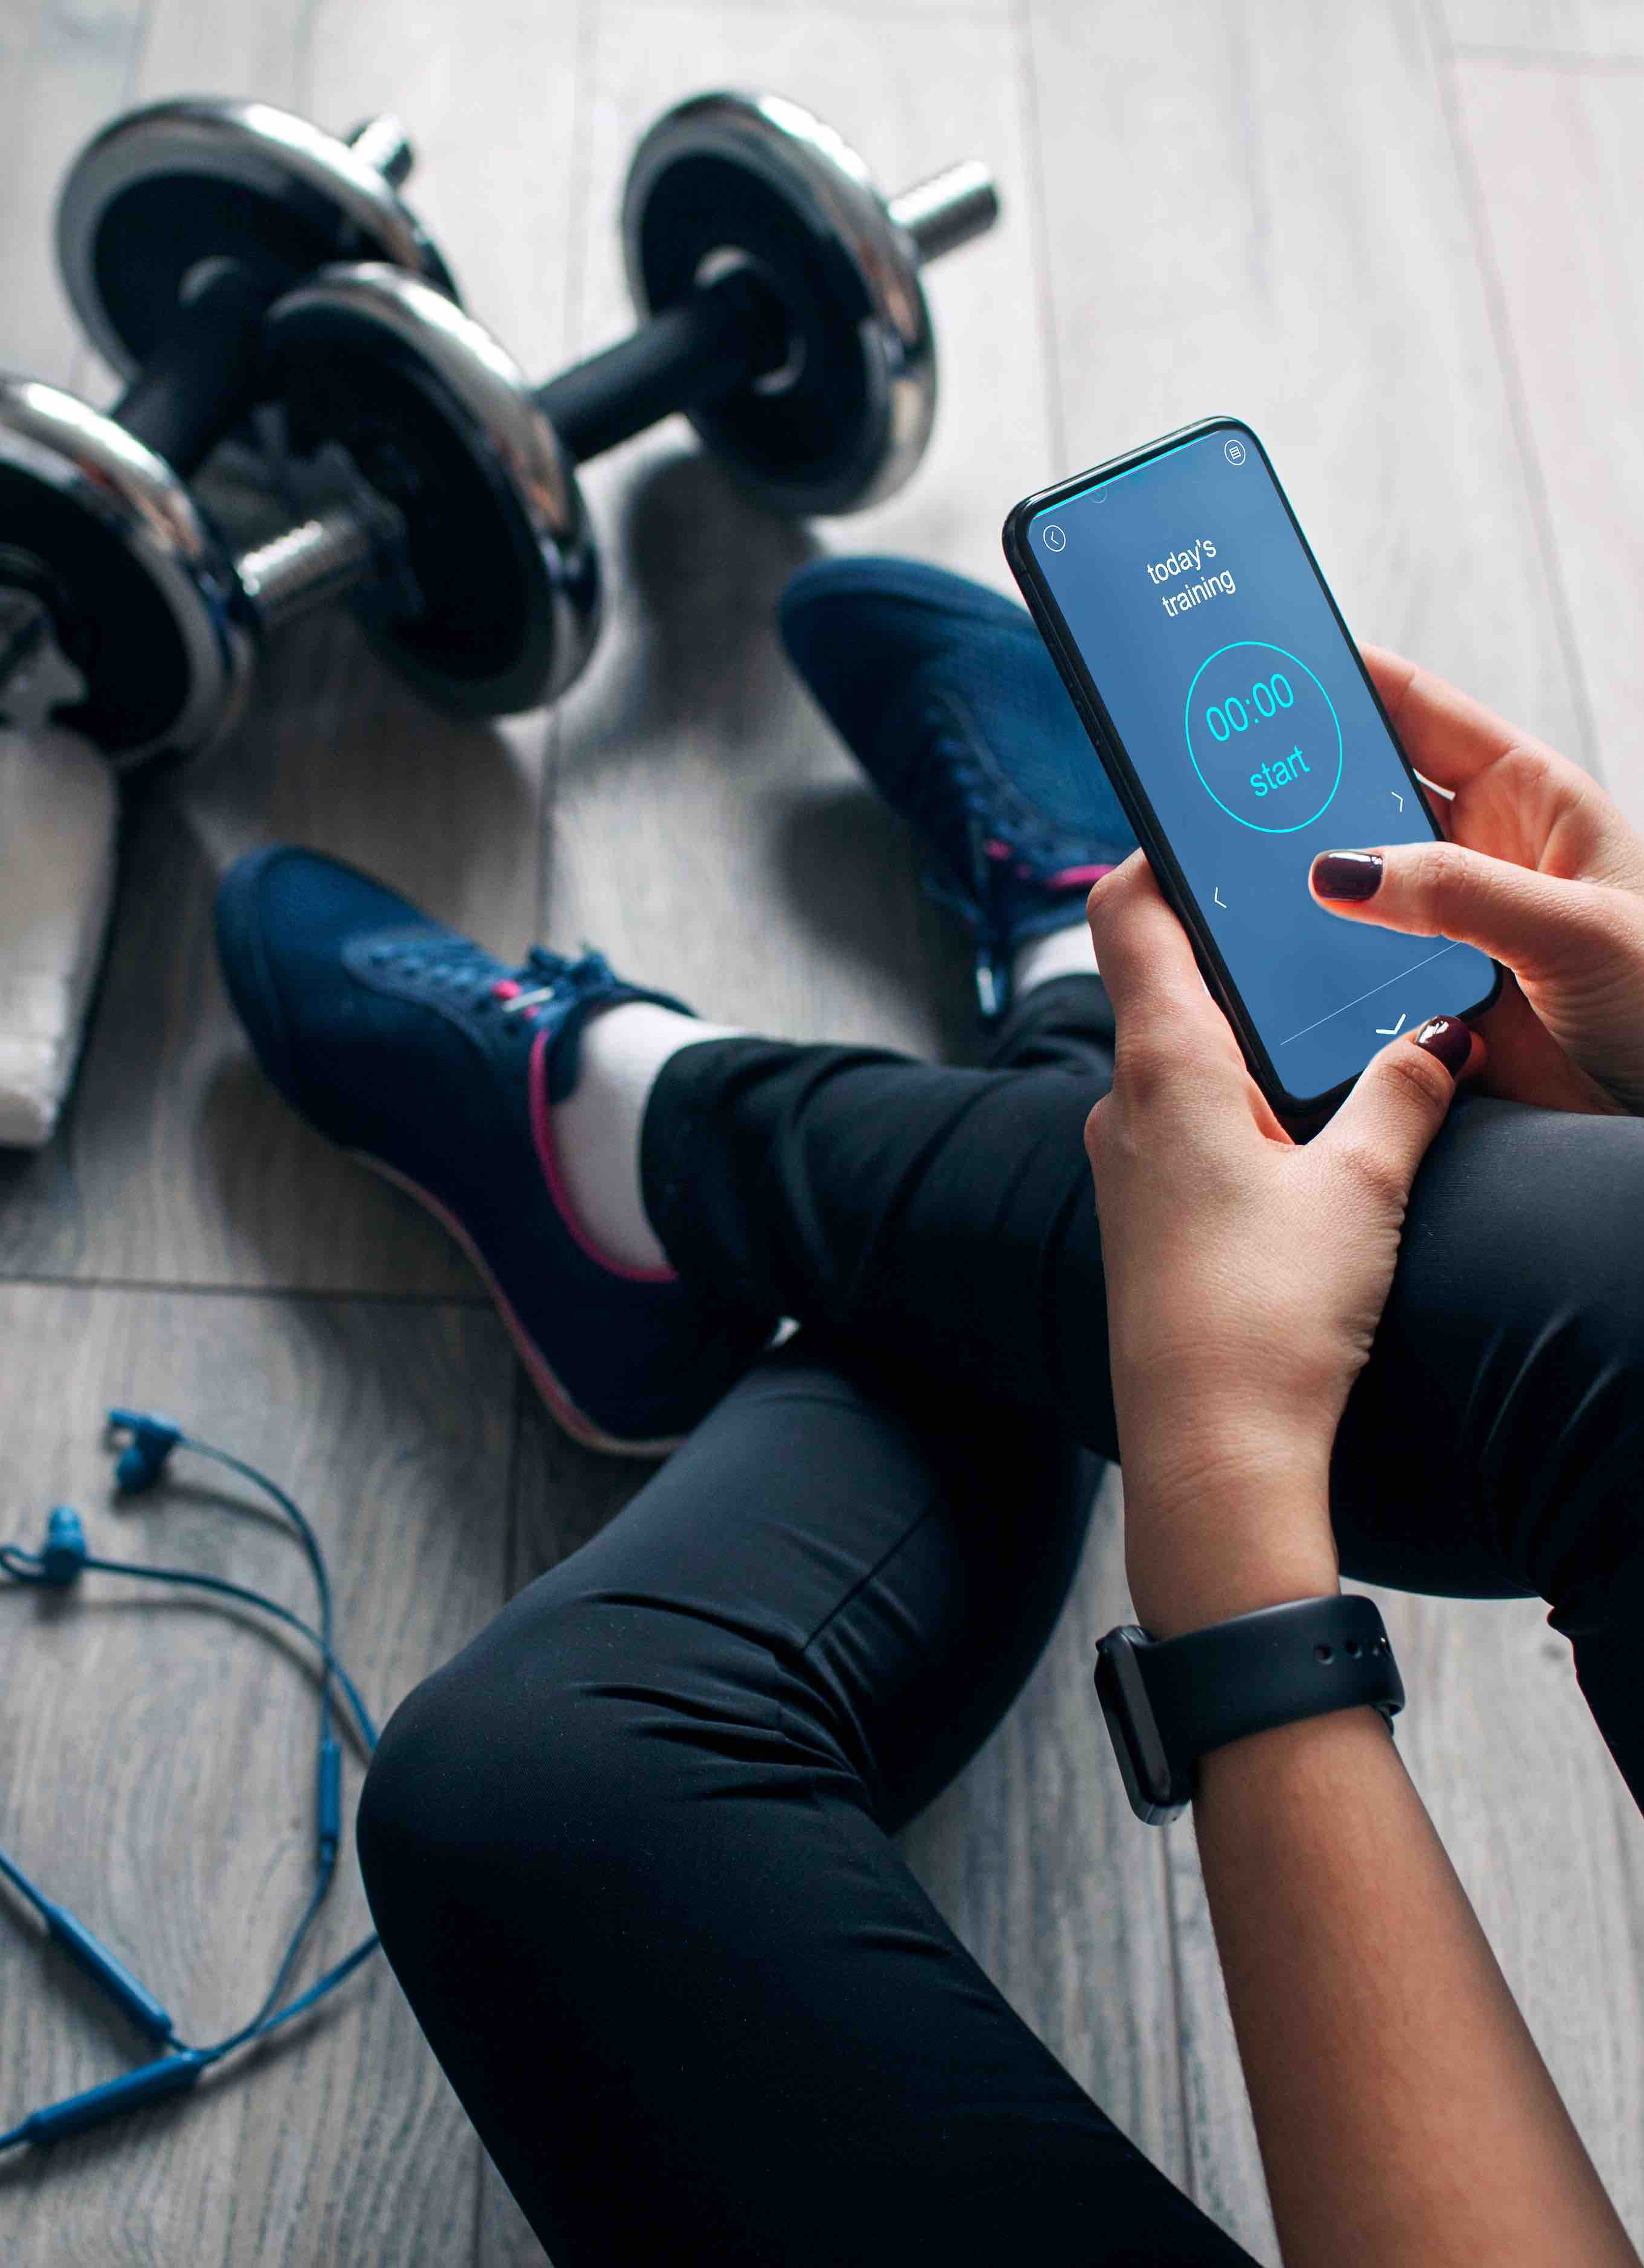
Overview | Justification | Benefits
Nature and context:
Technology plays a huge role in today's world in businesses and organizations:
Networking
Success
Reaching more Clients
Growth
Overview of previous studies:
We gained many important information from an interview held with the 5AM Club owner
Goals
About the business and its history
Ideas and requirements
Justification of research:
Having a mobile app is somewhere where this organization could be lacking
There are already a bunch of independent fitness apps out there
Our client Is a fitness club not a gym providing us uniqueness into the market.

Slide 8
Benefits
Benefits to the academic area:
Companion fitness app for the community with a more direct goal of building an application that enhances the experience of the 5AM Club members.
Improve on shortcoming that other fitness applications have.
Lack of certain features and user friendliness
Benefits to the company:
Important features into one application
Allow members to manage memberships from their phones at any time
Increased members
Company exposure
Community interest
Benefits to the researchers:​
Learning how to cope working well in a team​
The development of this application can be great on our portfolio​
Learning new tools and technologies​
Kotlin​
Android Studio​
Firebase​

Slide 9
Methodology
Agile and Iterative approach.
The application was divided into core features.
Each feature underwent multiple iterations.
The team had a meeting every week to review progress and set new goals. SCRUM like approach.
Git and GitHub was used to make collaboration easy.
Each core feature was developed on a separate branch.
After completion it was merged into a testing branch for testing.
Finally, after the testing branch had passed all the tests, it was merged into the main branch.

Slide 10
App Design
Mobile App Tools and Technologies
Mobile platform
We created an Android application.
IDE and Programming Language
IDE: Android Studio
Programming Language: Kotlin
UI framework: Jetpack Compose
Database and backend
Firebase.
Version control
Git
GitHub

Slide 11
Implementation Issues and Prototypes
Version Control
Problems with GitHub over multiple computers.
App Freezes
Network requests that took over 5 seconds froze the app.
Moving network requests to I/O thread.
Persistent Data across screens
Complex data is difficult to transfer from screen to screen
Shared View Models

Slide 12
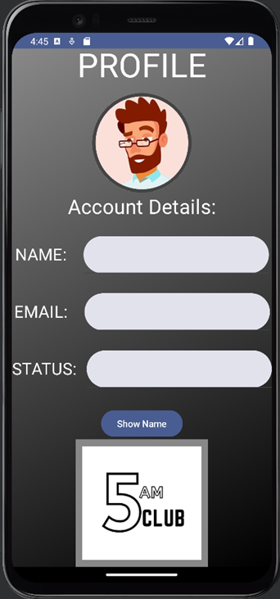
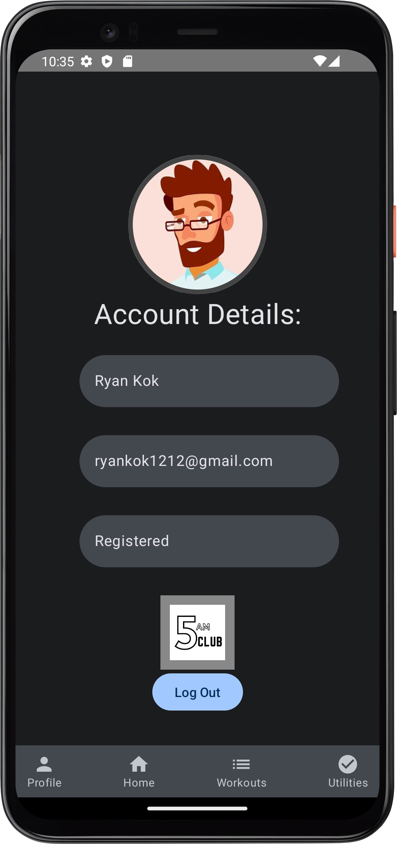
Implementation Issues and Prototypes
Prototype 1
Prototype 2

Slide 13

Research Results:
Our group faced uncertainty due to lack of experience in mobile app development, leading to extensive research for successful development.
Challenges were encountered in each page, but research enabled us to implement necessary functionalities. Selecting backend services, Firebase was chosen despite initial unfamiliarity, proving successful in simplifying authentication and data storage.
Further research helped us style efficiently in Kotlin for visually appealing pages. Past research saved time and difficulties, allowing timely development within our desired scope. Overall, research benefited us in authentication, styling, data handling, and Git collaboration, yielding significant benefits for app development.

Slide 14

Research Analysis & Recommendations:
An analysis of our research project is that we achieved the goals we set out in creating a companion app for the 5AM Club. We also successfully implemented the scheduling system, and were happy with the look and feel of the app. However we failed to implement features such as a payment system and community chat section in the given time.
Potential future additions included a chat feature using Firebase and integrating the app's events with the phone's calendar through Android's built-in API.

Slide 15

LAYOUTS AND INTERACTIONS

Slide 16
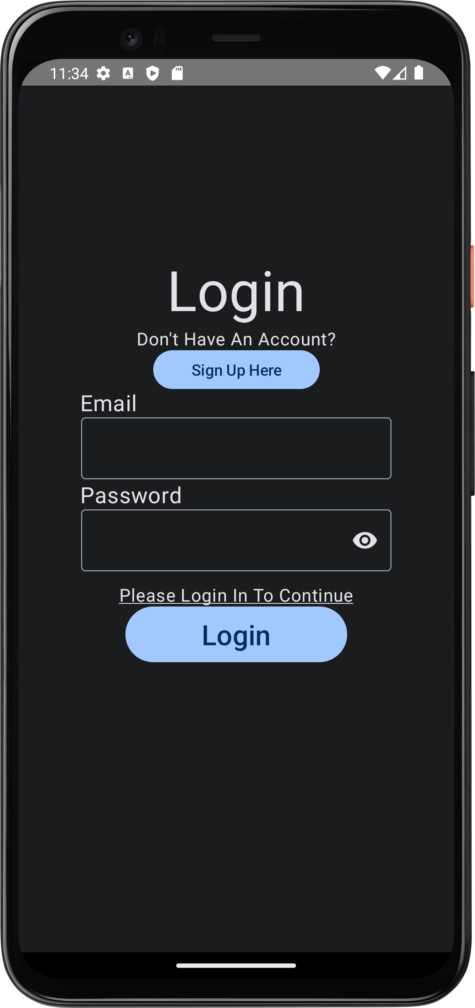
LOGIN SECTION
Login Page
Enter your details
Basic Validation
Sends you to home page or register screen
Password visibility
Built using Jetpack Compose

Slide 17
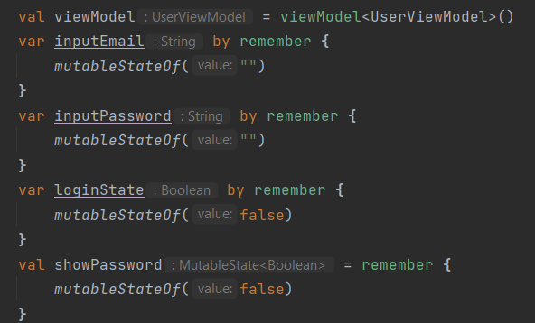
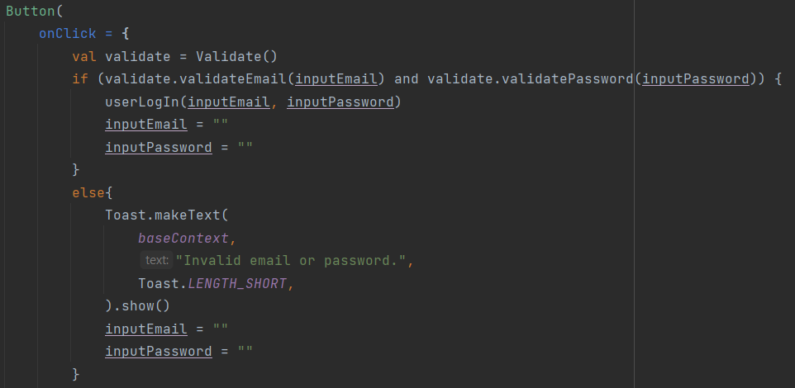
Variables using remember
Compose redraws the screen
Persistent data
Button to login
Validation class
Custom login function
Resets the input fields

Slide 18
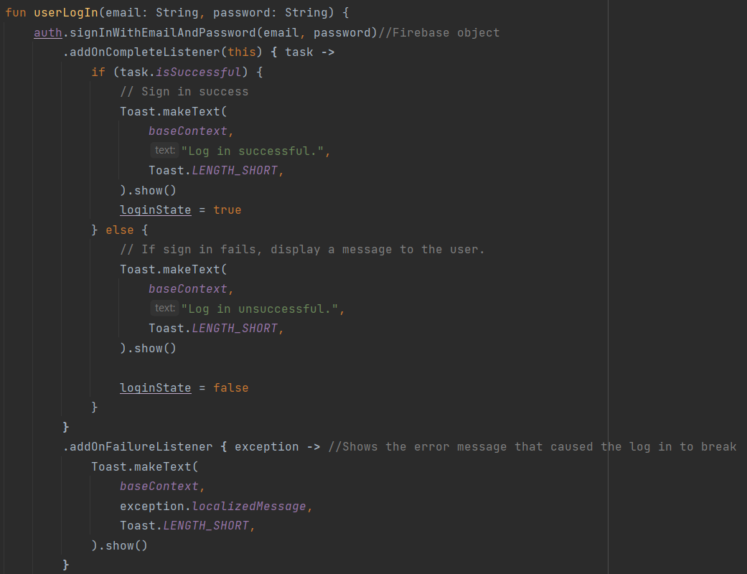
Custom Login function
Signs in using a Firebase object
Adds listeners
Alters the login state variable on completion
Displays two toast messages on login failure

Slide 19
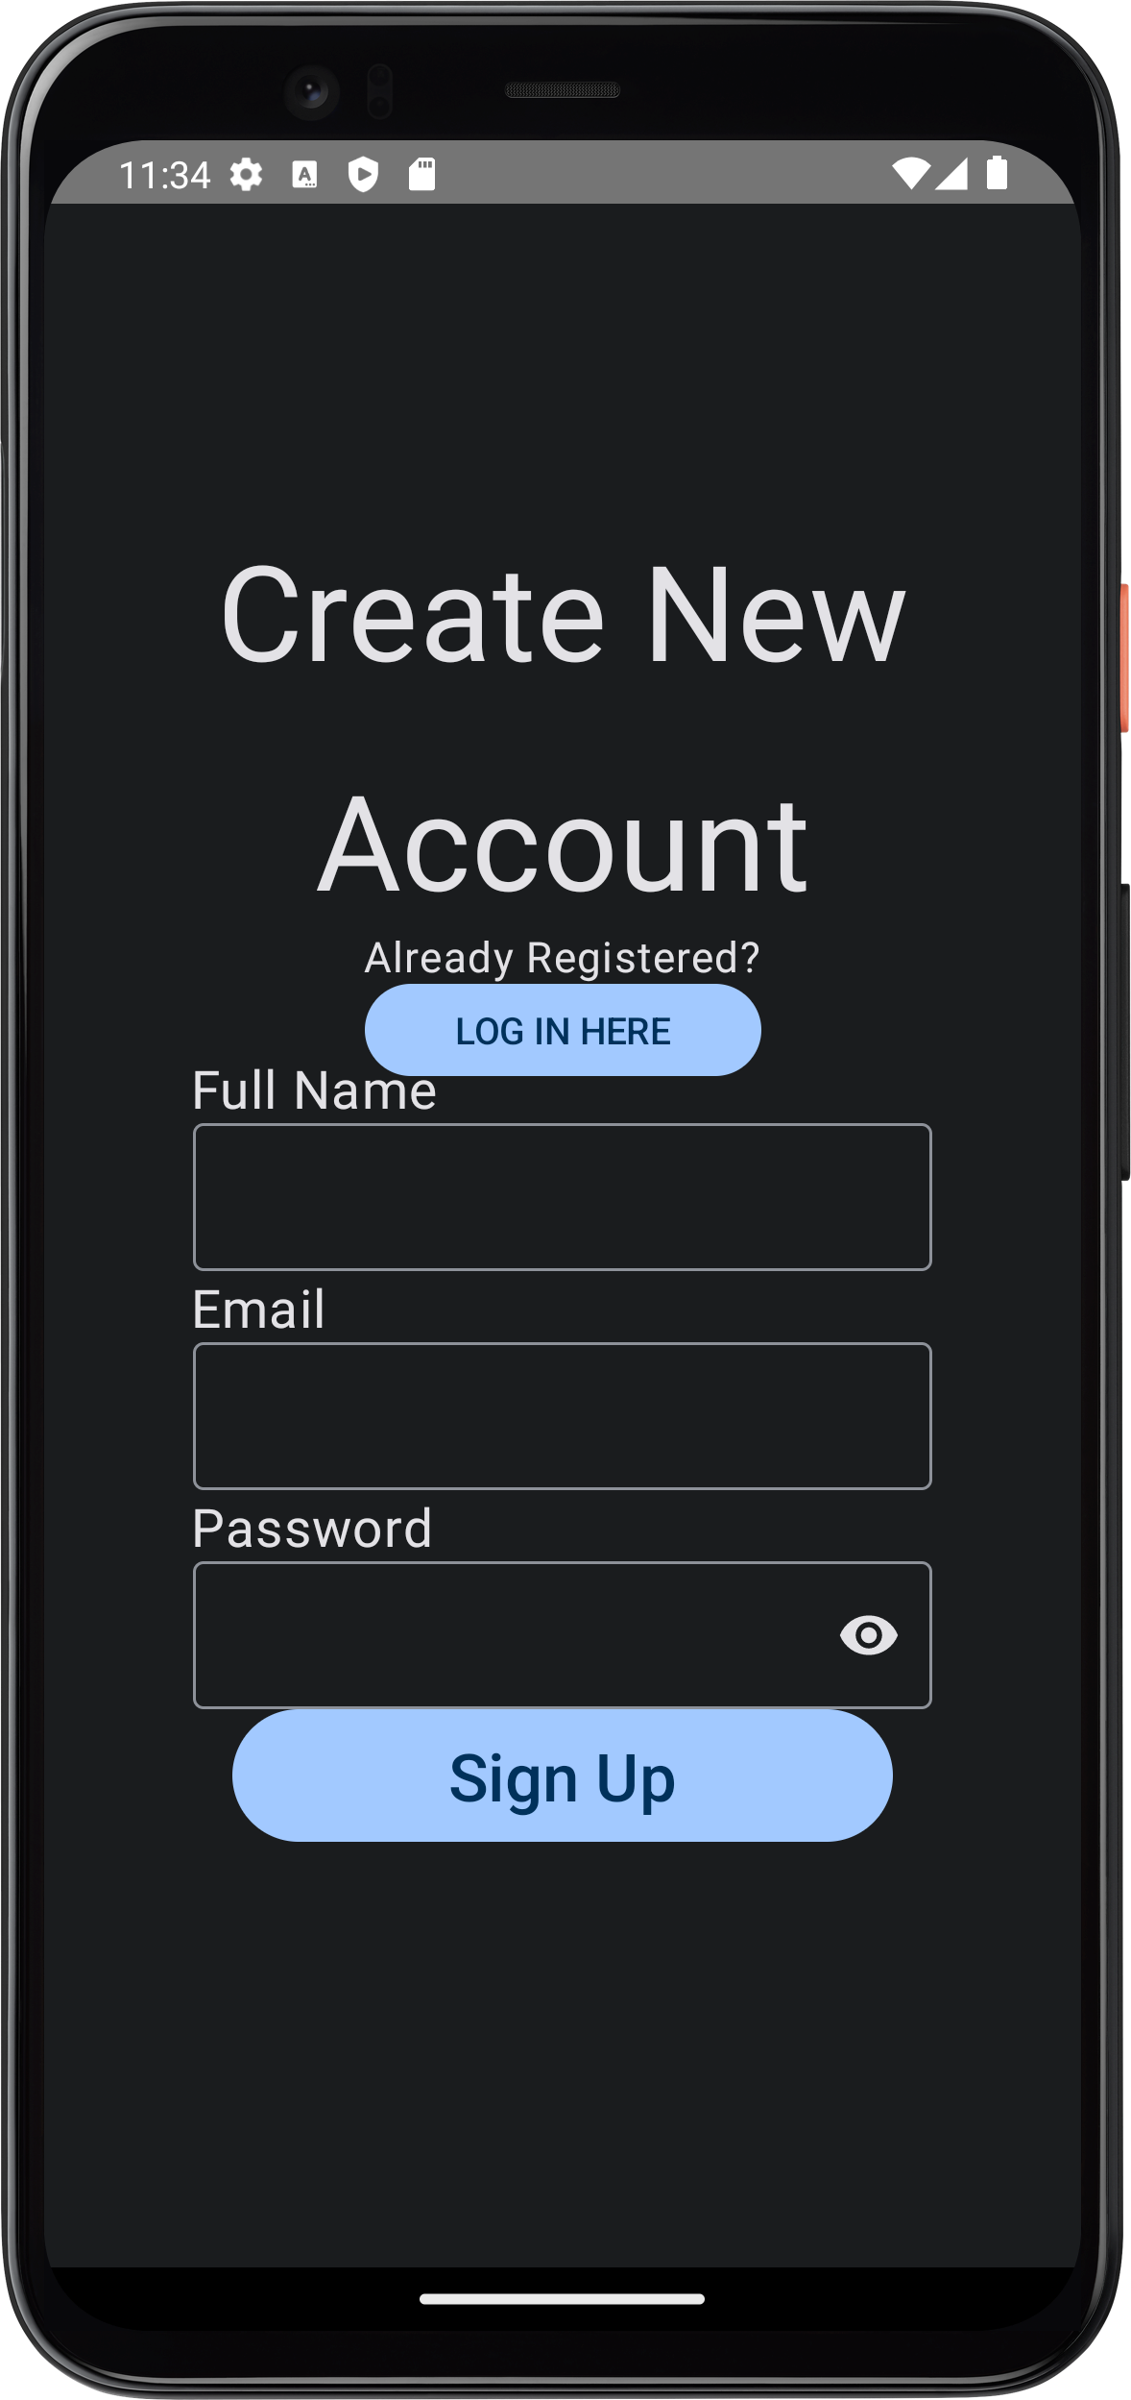
REGISTER SECTION
Register Page
Basic Validation
Sends you to login screen

Slide 20
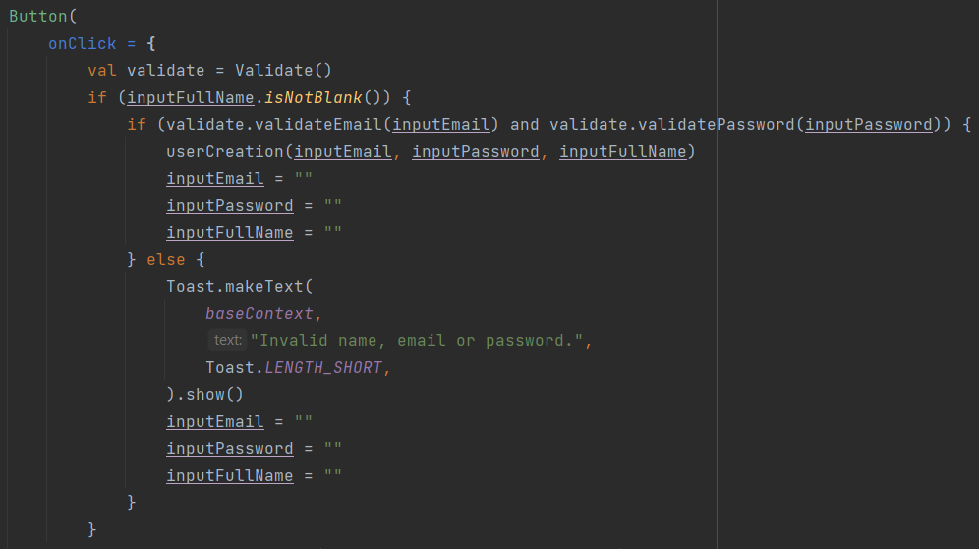
Button to login
Validation class
Custom login function
Resets the input fields

Slide 21
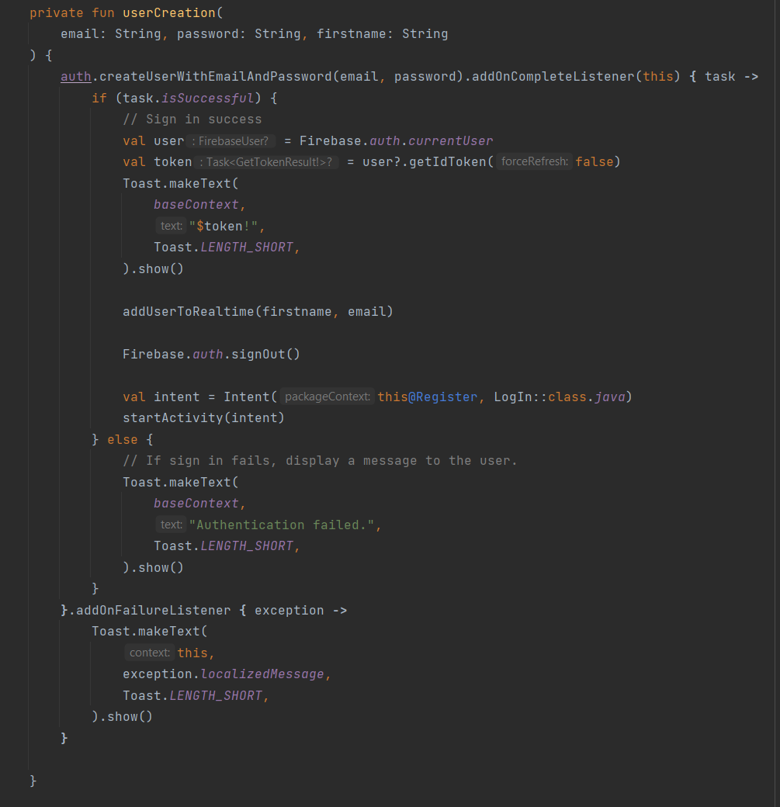
Custom function to creation new Firebase user
CreateUserWithEmailAndPassword is a Firebase function
Custom function to add user to Realtime database

Slide 22
Home Page
Has a calendar function to show any events held by The 5 am Club.
Shows the clubs presented by The 5am Club as well.

Slide 23
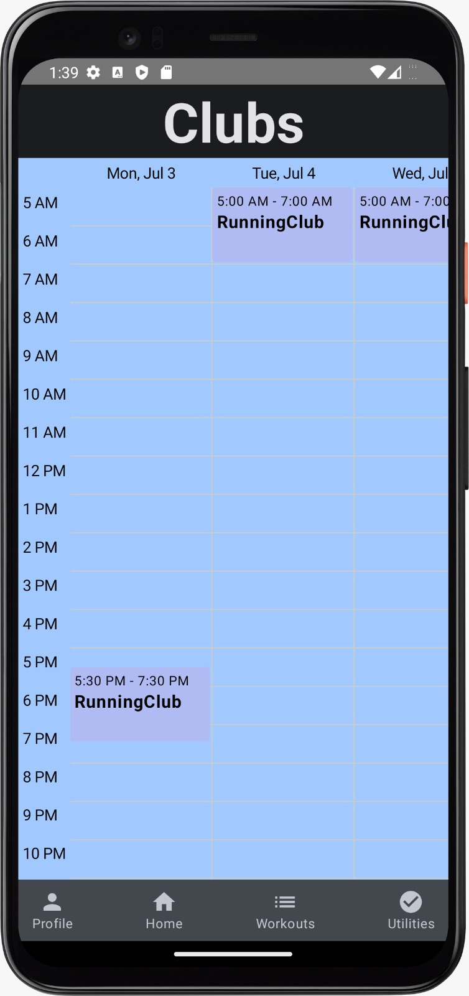
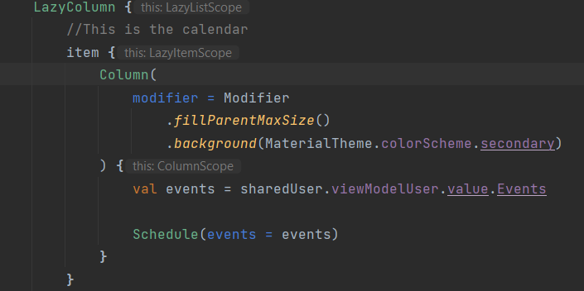
Home Page Calendar Section

Slide 24
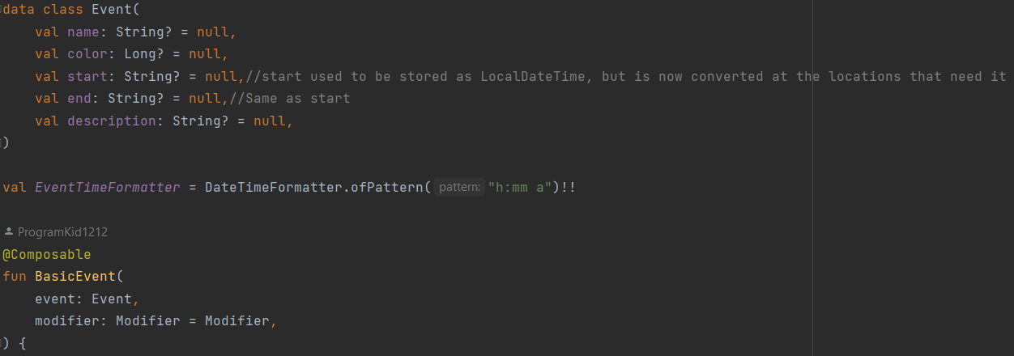

Slide 25
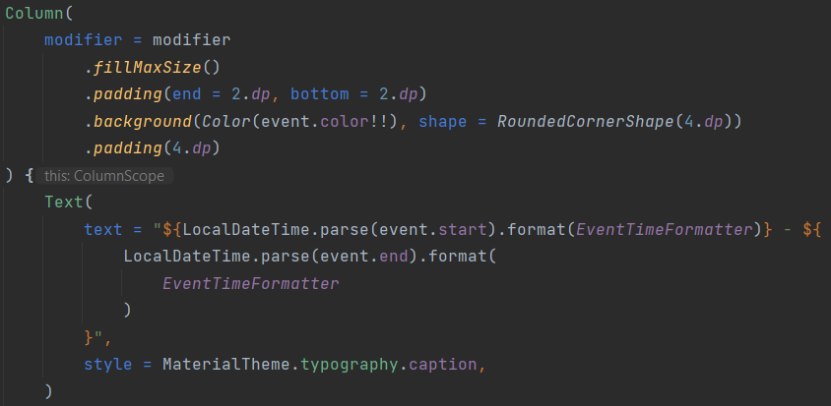
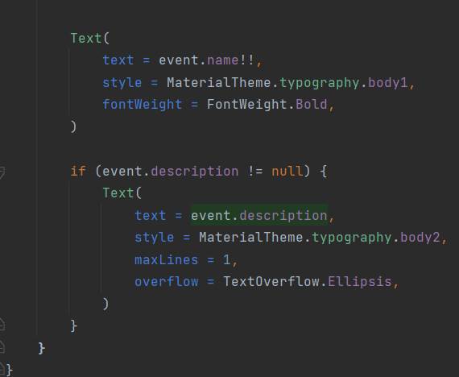

Slide 26
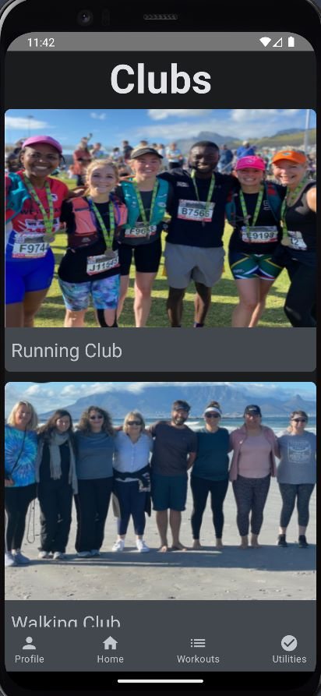
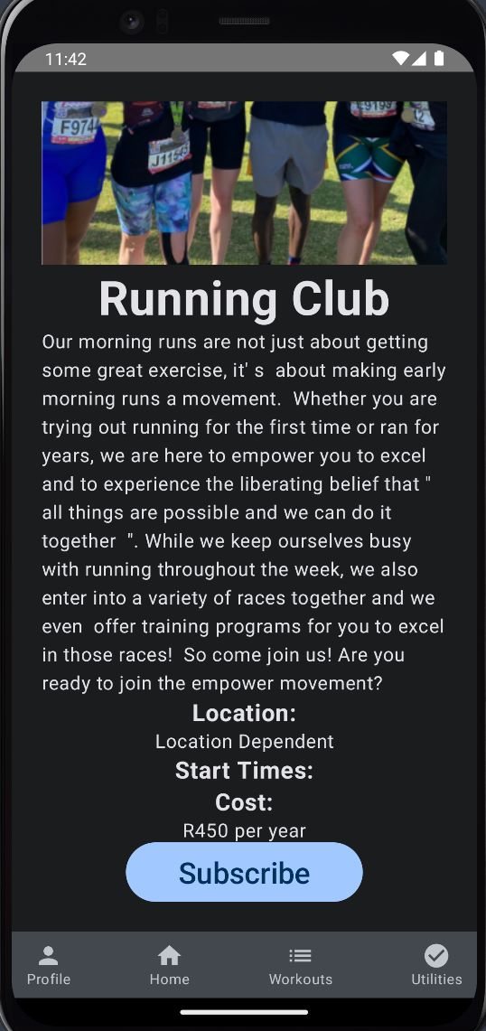
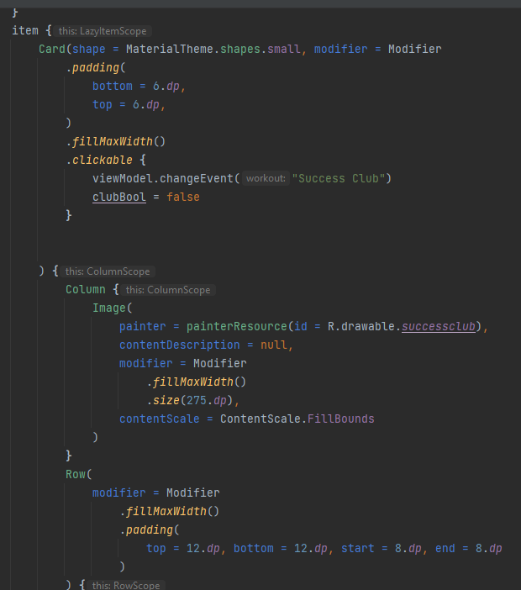
HOME PAGE CLUBS SECTION
Code for creating clickable club card, displaying all club info and subscribe button

Slide 27
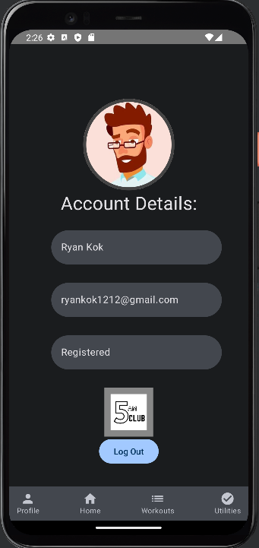
PROFILE PAGE
Snippet representing the layout and design of the profile page
Shows the users details
Shows 5AM Clug logo
Log out button

Slide 28
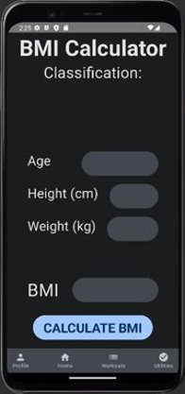
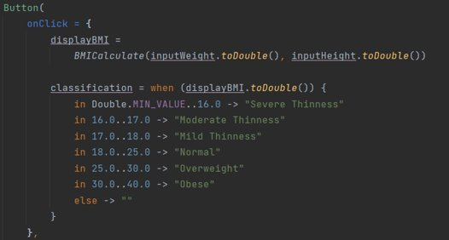
UTILITIES PAGE
BMI PAGE
Shows the BMI calculator on the utilities page
Custom function to represent the different classifications.

Slide 29
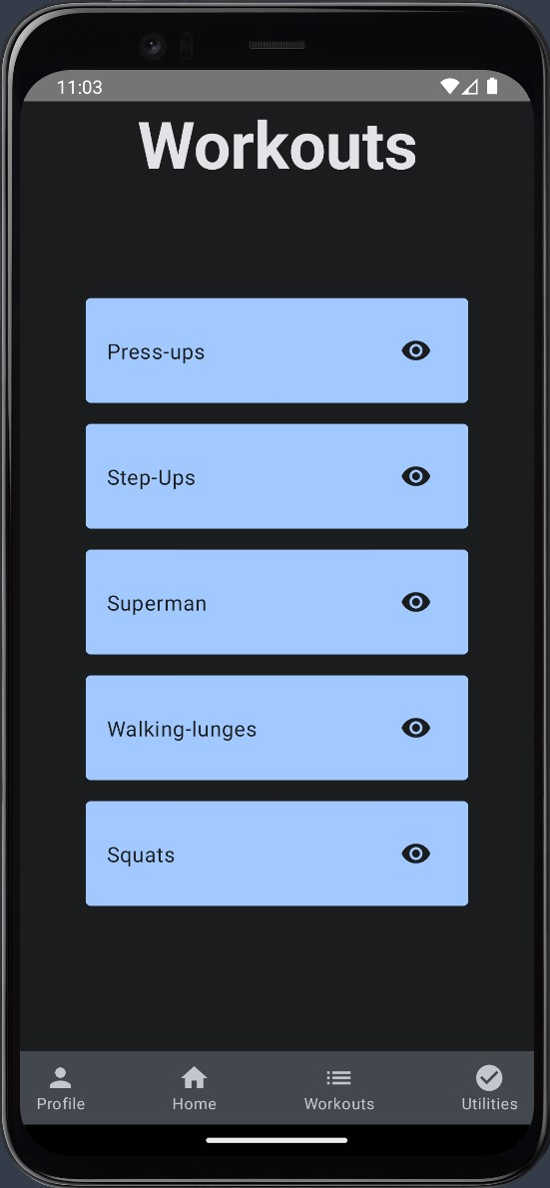
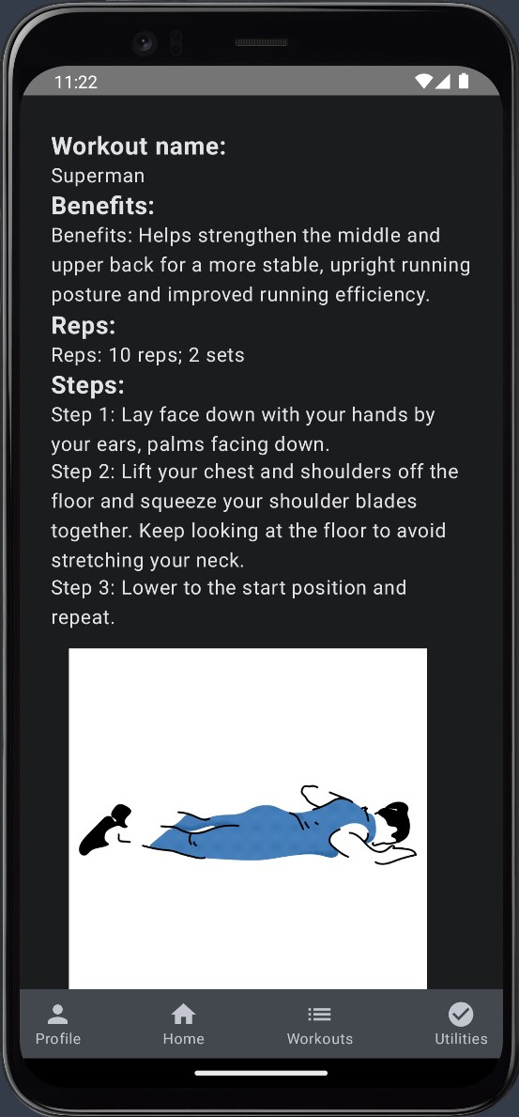
Workouts Page
Allows users to view various workouts
Provides overview of benefits, reps, and steps.
All workouts are stored and retrieved from the Realtime Database.

Slide 30
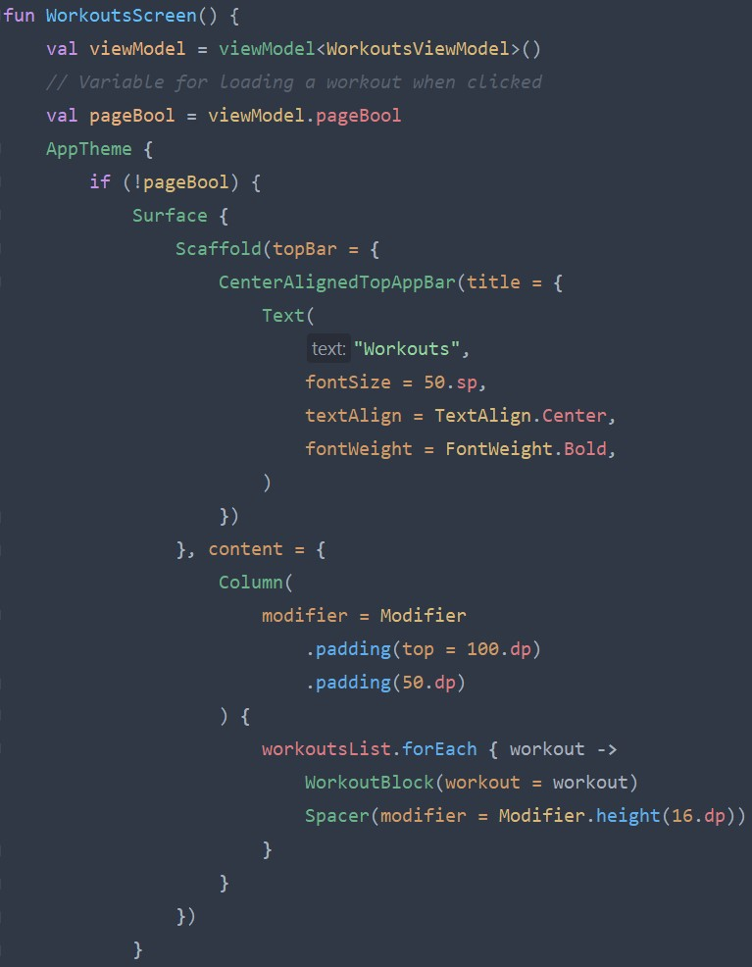
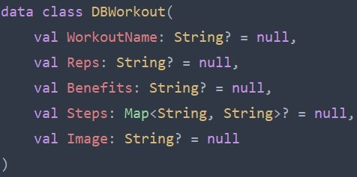

Slide 31

DATA STORAGE

Slide 32
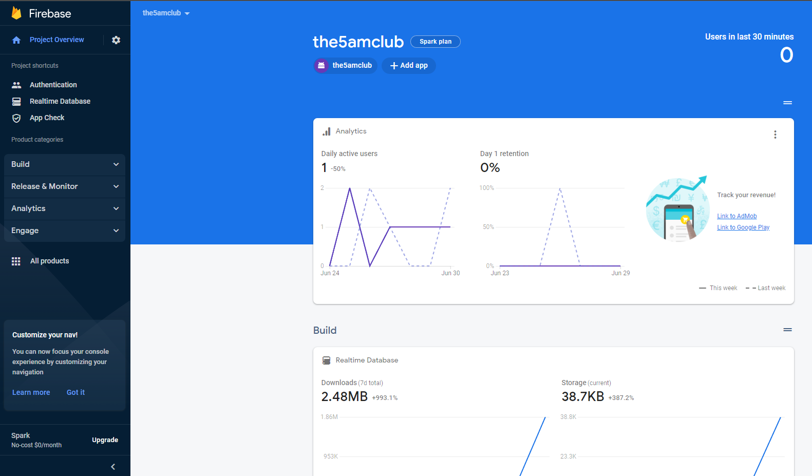
DATABASE STORAGE
Firebase
App development platform backed by Google
Authentication server
Realtime Database

Slide 33
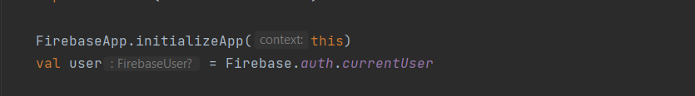
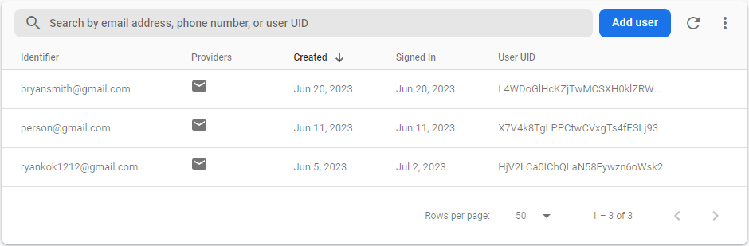
DATABASE STORAGE
Authentication Server
Stores specific details about the user
Email, password
Multiple sign-up methods
Tight security
Firebase objects in code
Allows us to check if the user is logged in already

Slide 34
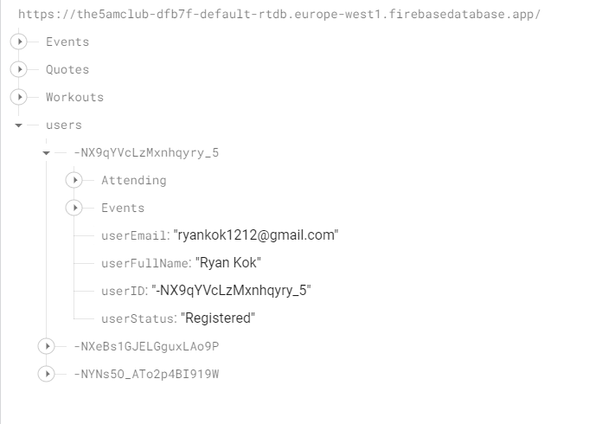
DATABASE STORAGE
Realtime Database
Can store any kind of information
Allows for in-depth details about users
Stored as a JSON tree
Allows reads and writes
Data is called into code using both data change listeners and queries
Each user has a unique ID key

Slide 35
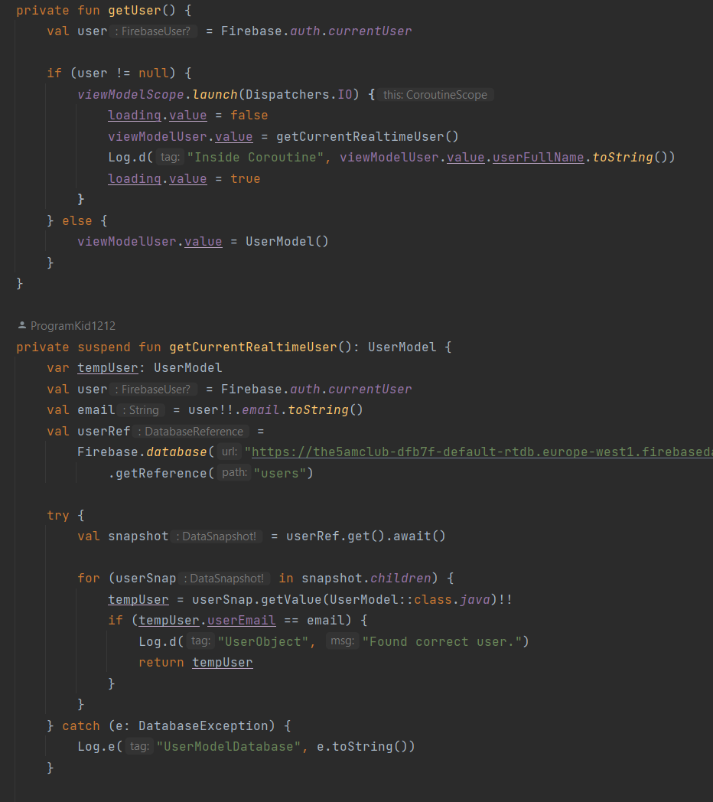
DATABASE STORAGE
ViewModel
In app ViewModel
ViewModel holds logic at a business level, so it persists over multiple screens
Only fetch data from the database once, instead of on every screen
Launching a coroutine on the Input and Output thread
Coroutines allow for multiple instances of code to run at the same time
It also allows different pieces of code to run at the same time as well, such as the UI layer

Slide 36
References:
Iversen, J. and Eierman, M. (2018) Mobile app development for IOS and Android. 3.0. Burlington, VT: Prospect Press. (Prescribed Textbook)
Altvater, A. (2023) 'What is Agile Methodology? How It Works, Best Practices, Tools,' Stackify [Preprint]. Available at: https://stackify.com/agile-methodology/ (Accessed: 13 June 2023).
Bhandari, P. (2023) 'Questionnaire Design | Methods, Question Types & Examples,' Scribbr [Preprint]. Available at: https://www.scribbr.com/methodology/questionnaire/ (Accessed: 13 June 2023).
Clifford Stein, Robert Drysdale, Kenneth Bogart (2011) 'Discrete Mathematics for Computer Scientists.' United States of America: Pearson Education.
Cloudflare (2023) 'What is BaaS? | Backend-as-a-Service vs. serverless,' [Online]. Available at: https://www.cloudflare.com/learning/serverless/glossary/backend-as-a-service-baas/ (Accessed: 17 April 2023).
Consagous (2022) 'What technologies are employed in fitness app development?,' Consagous. Consagous. (Accessed: 15 April 2023).
Gaddis, T. (2013) 'Starting out with Programming Logic & Design.' United States: Pearson Education.
Hagarty, R. (2002) 'Discrete Mathematics for Computing.' Malaysia: Pearson Education Limited.

